Slide 1
Theory of Automata Chomsky Normal Form
Week 8

Slide 2
Contents
Definition – CNF
Theorem
Left most derivation
Parsing

Slide 3
Chomsky Normal Form (CNF)
Definition
If a CFG has only productions of the form
Non-Terminal → string of exactly two non-terminals
OR
Non-Terminal → one terminal
It is said to be in Chomsky Normal Form (CNF).
Notes:
3

Slide 4
Theorem 25
If L is a language generated by some CFG, then there exist another CFG that generate all the non-null words of L, all of whose productions are of one of the two basic forms:
Non-Terminal → string of only Non-terminals
Or
Non-Terminal → one Terminal
Notes:
4

Slide 5
Proof
The proof is a constructive algorithm by converting a given CFG in a CFG of the production of designed format.
Let us suppose in given CFG the non-terminal are S, X₁, X₂, X₃, … . Let us also assume {a,b} are two terminals.
STEP-1
We now add two new non-terminals A and B and the productions
A → a B → b
Notes:
5

Slide 6
Proof Theorem 25 contd…
STEP-2
now for every previous production involving terminals, we replace each ‘a’ with the non-terminal A and each ‘b’ with B.
e.g. X₃ → X₄aX₁SbbX₇a
Becomes
X₃ → X₄AX₁SBBX₇A
Which is a string of solid non-terminals
X₆ → abaab
Becomes
X₆ → ABAAB
Notes:
6

Slide 7
Example
S → X₁ | X₂aX₂ | aSb | b
X₁ → X₂X₂ | b
X₂ → aX₂ | aaX₂
S → X₁ | X₂AX₂ | ASB | B
X₁ → X₂X₂ | B
X₂ → AX₂ | AAX₂
A → a
B → b
Notes:
7

Slide 8
Theorem
If CFG G = (V, ∑, P, S) is in CNF form if each rule has one of the following form
A → BC
A → a
S → Λ
Where B, C ∈ V – {S}
Pre-Conditions
The start symbol is non-recursive
G does not have lambda rules other than S → Λ
G does not contain unit/chain rules
G does not contain useless symbols
Notes:
8

Slide 9
Proof of theorem
The rules of type ii, and iii already fulfill CNF condition so that become part of CNF directly
Right sides of other production may contain terminals and non-terminals
e.g. N → aM | NaMb
We need to have string of solid non-terminal on right side we introduce new products as X→ a Y → b
And apply them to all rules getting
N → XM | NXMY
Notes:
9

Slide 10
Proof contd.
Introduce new non-terminals to restrict the length to 2
N → XM | NXMY
N → XM X → a
N → NR₁ Y → b
R₁ → XR₂
R₂ → MY
Notes:
10

Slide 11
Theorem 26
Theorem 26:
For any context-free language L, the non-Λ words of L can be generated by a grammar in which all productions are in CNF.
Notes:
11

Slide 12
Proof of Theorem 26
The proof will be by constructive algorithm.
From Theorems 23 and 24, we know that there is a CFG for L (or for all L except Λ) that has no Λ-productions and no unit productions.
Suppose further that we have made the CFG fit the form specified in Theorem 25.
For productions of the form
non-terminal → one terminal
we leave them alone.
For each production of the form
non-terminal → string of non-terminals
we use the following expansion that involves new non-terminals R₁, R₂, ...
Notes:
12

Slide 13
Proof of Theorem 26 contd.
For instance, the production S → X₁X₂X₃X₈ should be replaced by S → X₁R₁
where R₁ → X₂R₂ and where R₂ → X₃X₈.
Thus, we convert a production with long string of non-terminals into a sequence of productions with exactly two non-terminals.
If we need to convert another production, we introduce new R’s with different subscripts.
The new grammar generates the same language as the old grammar with the possible exception of the word Λ.
Notes:
13

Slide 14
Remarks
Theorem 26 has enabled a form of algebra of productions by introducing non-terminals R₁, R₂, R₃ …
The derivation tree associated with a derivation in Chomsky Normal Form grammar is a binary tree.
Notes:
14

Slide 15
Example (Non-Palindrome)
S → aSa | bSb | a | b | aa | bb
S → ASA
S → BSB
S → AA
S → BB
S → AR₂
R₂ → SA
S → BR₁
R₁ → SB
S → AA
S → BB
S → a
S → b
A → a
B → b
Notes:
15

Slide 16
Leftmost Derivation
Definition:
The leftmost non-terminal in a working string is the first non-terminal that we encounter when we scan the string from left to right.
Example: In the string abNbaXYa, the leftmost non-terminal is N.
Definition:
If a word w is generated by a CFG such that at each step in the derivation, a production is applied to the leftmost non-terminal in the working string, then this derivation is called a leftmost derivation.
Notes:
16

Slide 17
Example: Left derivation
S → aSX | b
X → Xb | a
aababa
S ➔ aSX
➔ aaSXX
➔ aabXX
➔ aabXbX
➔ aababX
➔ aababa
Notes:
17

Slide 18
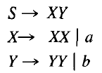
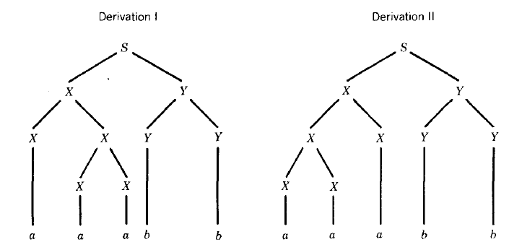
Left derivation

Slide 19
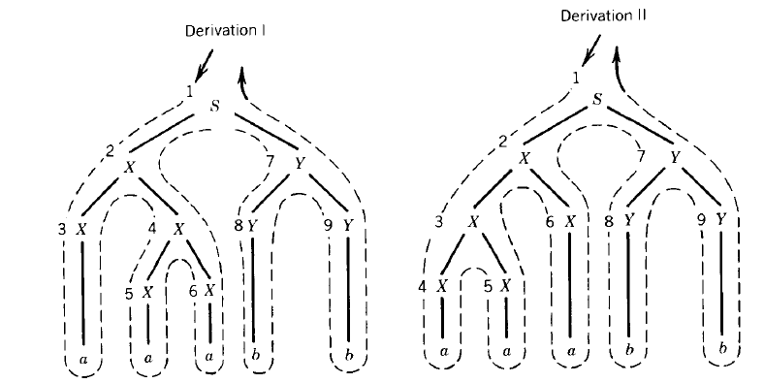
Left derivation

Slide 20
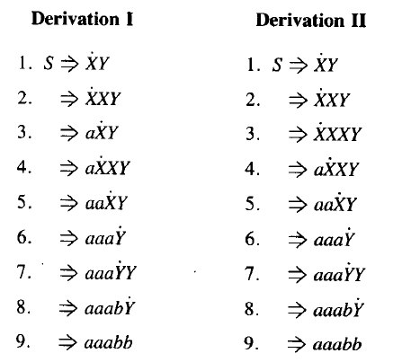
Left derivation

Slide 21

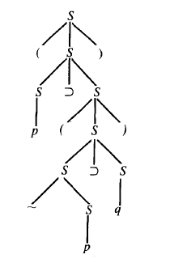
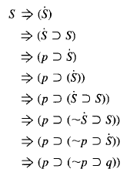

Slide 22
Parsing
Definition: the process of finding the derivation of word generated by particular grammar is called parsing.
There are different parsing techniques, containing the following three
Top down parsing.
Bottom up parsing.
Parsing technique for particular grammar of arithmetic expression.
Notes:
22

Slide 23
Top down parsing
Following is an example showing top down parsing technique
As can be observed from the name of top down parsing, the parsing starts from the non-terminal S and the structure similar to that of total language tree is developed. The branches of the tree are extended till the required word is found as a branch.
Notes:
23

Slide 24
Convert to CNF
E -> E+E
E -> E*E
E -> (E)
E -> 7
S->ABABAB
A->a|∆
B->b| ∆
S->SaS |SaSbS |SbSaS | ∆

